Slide 1


socialHub: Your Social Network of the Future
Get ready to experience the future of social networking with socialHub! We're a platform built to connect, engage, and empower individuals from all corners of the globe.
by Krish Vora

Slide 2

What is socialHub?
Find Your Friends
Express Yourself
Connect with people who share your interests and passions.
Share your thoughts, photos, videos, and more.

Slide 3
Key Features
Personalized Feed
Add Friends
Profile Of Friends
A dynamic feed tailored to your interests, showing content from people and groups you follow.
you can have ability to see you friends post and profile.
you can have see other persons profile.
and also see your profile page to chech total posts of all likes.
like :- recents posts, saved posts,liked posts, friends posts.

Slide 4
Key Features
Save Posts
Like Posts
Upload Post
Saving posts is a private action, meaning other users cannot see what someone has saved. Users might save posts that they prefer to keep private or for their own reference.
You can view the posts you've liked from your profile page by clicking or tapping into the Likes tab. Click or tap the like icon and it will turn red, confirming that you've liked the post.
You can upload posts to share in socialHub.

Slide 5

User Experience
1
Intuitive Interface
2
Your Interests Posts
3
Easy Connect With Friends
A user-friendly design that is easy to navigate and understand.
You can see the posts which you want ,
making the ability to connect with and interact with other users, essentially "friends," a central and prominent function within the platform, allowing users to easily search, add, and engage with people they know, fostering a sense of community and social interaction.
like recents posts, only friends posts,liked posts, saved posts.

Slide 6

Engagement Strategies
1
Friends list
this is show the frinds list by which you can able to see your friends directly from home
2
Remove friends
As per your interests you can able to remove friends.
3
Friends Posts
If you want to see your friends post then you can do this , and also like and posts .

Slide 7
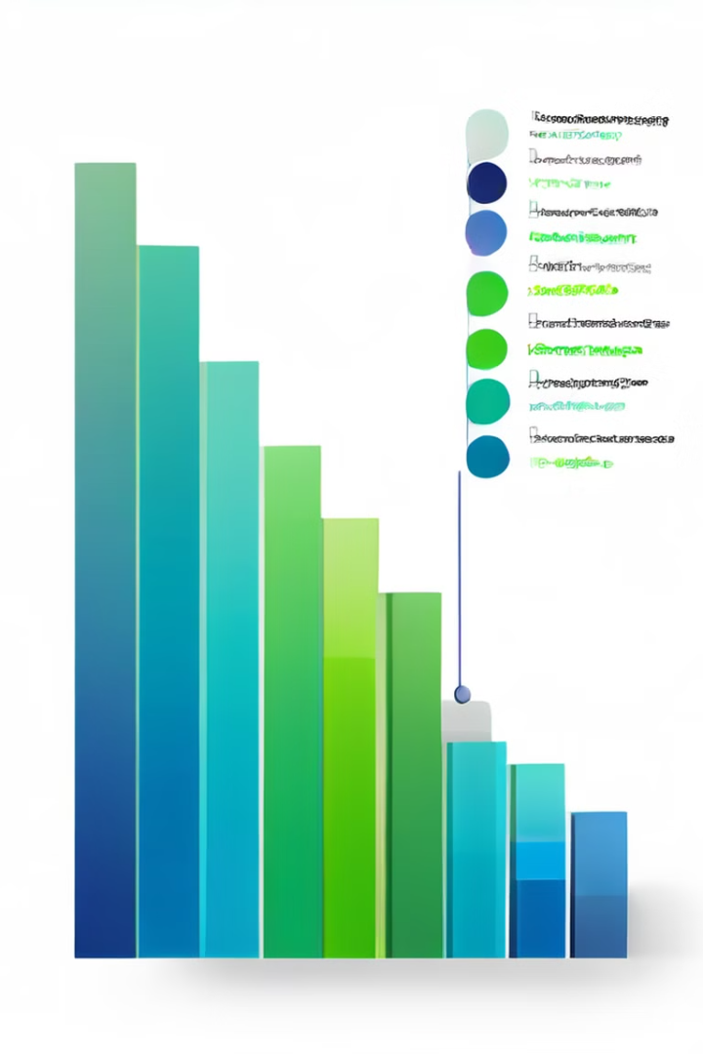
Analytics and Insights
User Demographics
Track user bio, Date of birth,username, and profile_photo.
Posts Data
At the admin side you can see the posts data like posts image, created_At date, posts creator, number of likes,etc…..
users
this is show you the authenticated user, last joined in our websites.

Slide 8



Integration and Scalability
Fully Database Supports
Cross-Platform Compatibility
database support like store and delete users specific data, posts data,etc…….
Ensure seamless user experience across multiple platforms, including web, mobile, and desktop.

Slide 9

Security and Privacy
1
Data Encryption
2
Privacy Controls
Protect user data with strong encryption algorithms. such as password encryption.
Provide users with control over their data and privacy settings.
3
Securly login
process that verifies a user's identity using multiple methods to ensure that only authorized users can access a website or system

